Slide 1
MAL1, Session 8
Artificial Neural Network

Slide 2
Limits of Support Vector Machines
In theory there are none!
You just need the right kernel
So what's the right kernel?
In some domains, like protein folding, there are special kernels
Apart from that, you're on your own
You can try the standard 4, but no guarantees
With too much hyperparameter fiddling, you risk overfitting
When SVMs (decision forests, ...) won't do, people use neural networks

Slide 3
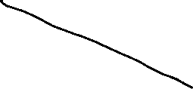



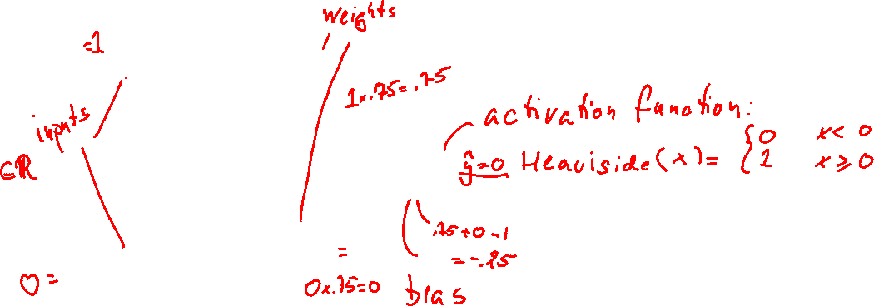

The Perceptron

Slide 4





Logical operators as perceptrons

Slide 5
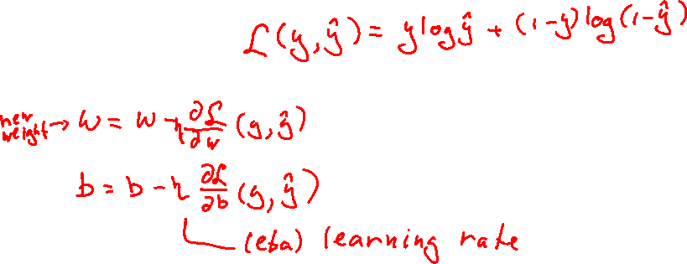
Training a perceptron
Optimize loss function:
Use gradient descent
But Heaviside isn't differentiable
Instead, use the sigmoid (logistic) function + rounding

Slide 6
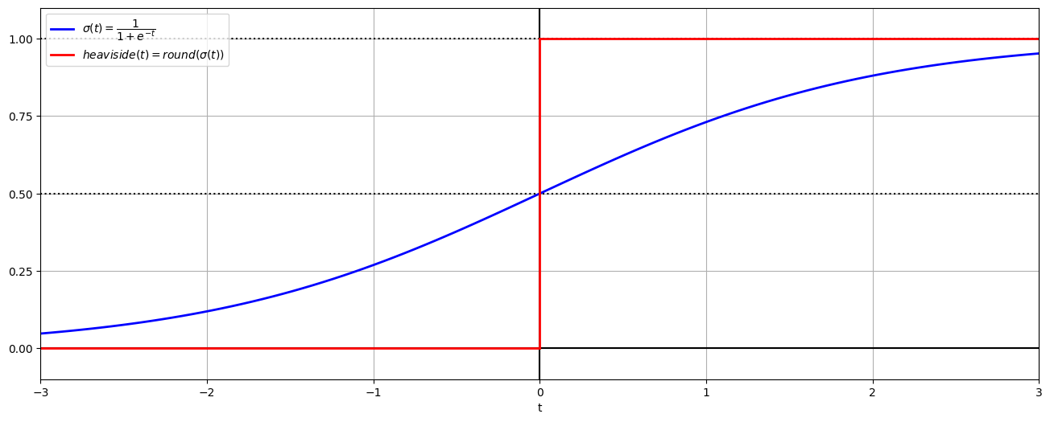
Sigmoid and Heaviside

Slide 7
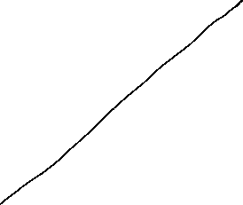


Math

Slide 8
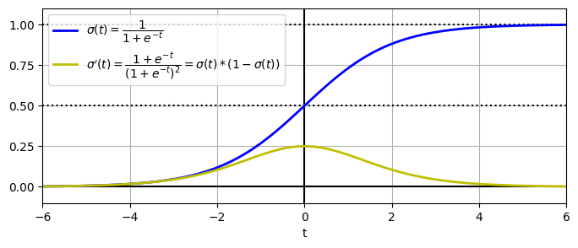
The sigmoid and it's derivative

Slide 9
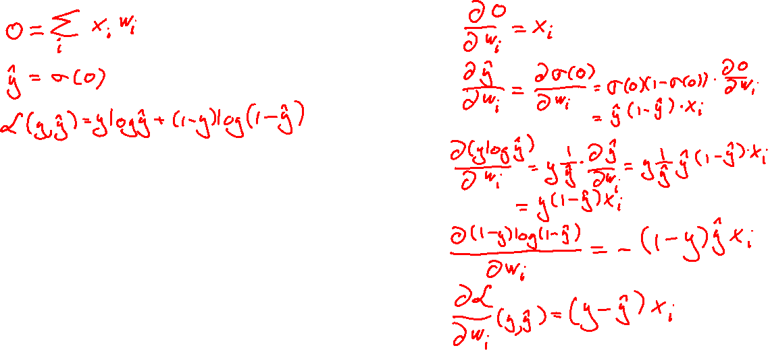
Let's derive

Slide 10
Stochastic Gradient Descent
Don't adjust after each sample
Too indecisive - diverges
Possible: Run all samples (an epoch) and adjust by the average
Converges too slowly
Stochastic gradient descent: In each epoch,
Divide samples into random batches
Run each batch
Adjust by average after each batch

Slide 11
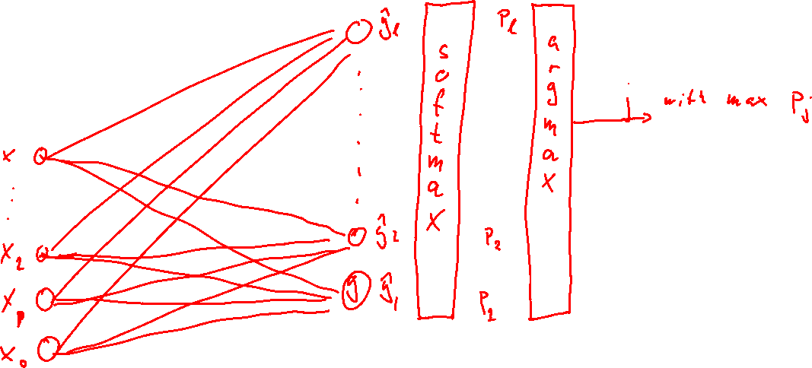
Non-binary output

Slide 12
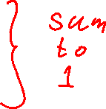
Softmax (multinomial) Regression
Binary regression:
Softmax regression for multiple categories, k = 1, 2, 3, ..., K

Slide 13
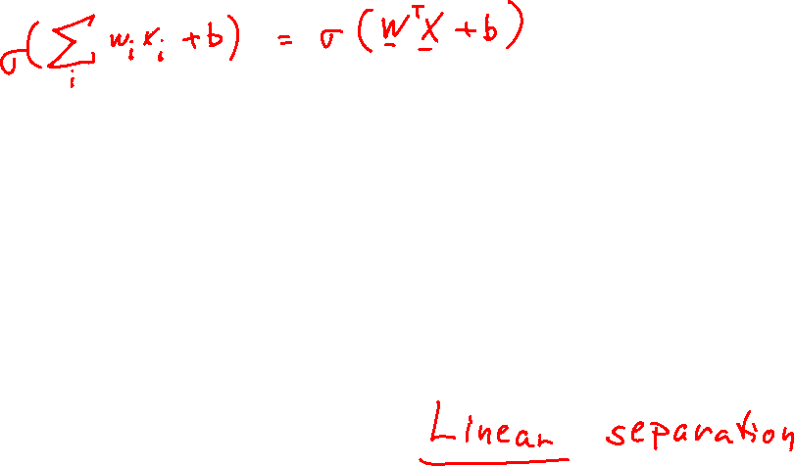
Have we met before?
This is just logistic regression!
What's the main limitation of logistic regression?

Slide 14
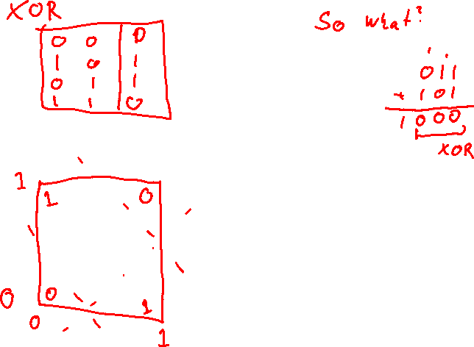
Not linearly separable: XOR

Slide 15
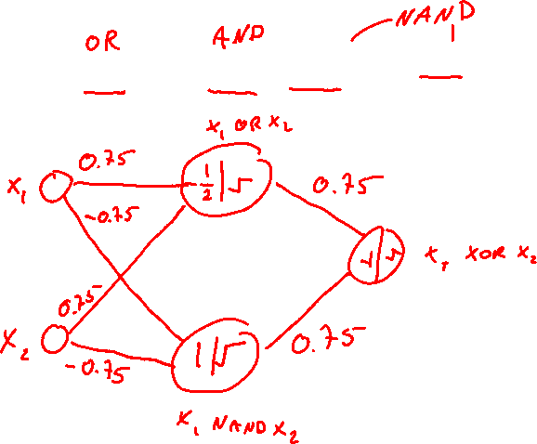



Now what?

Slide 16


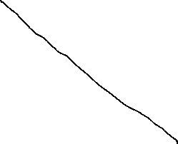


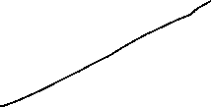
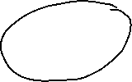

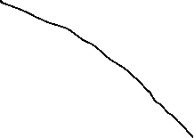

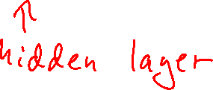

XOR

Slide 17



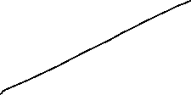

Multi-layer neural networks

Slide 18
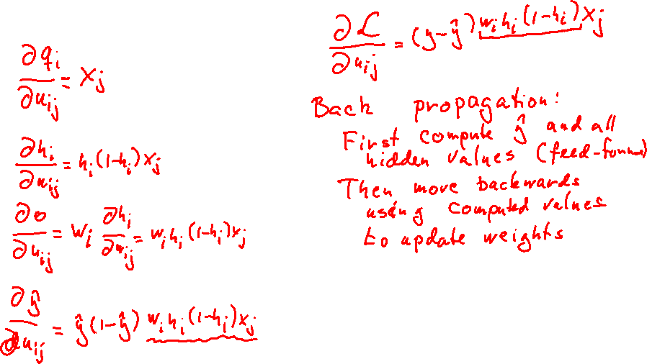
Derivations

Slide 19
Back propagation
After feeding forward, we adjust weights by propagating backward
This is a direct consequence of the chain rule
We can add different kinds of layers, as long as you know the derivative
We can build more advanced types of networks
Understanding the feed forward mechanism is enough
We (the book, the documentation, the literature, me) call this learnable layers and parameters
On the flip side, this expression: h(1-h) = σ(q)(1-σ(q))
When h is near 0 (q low) or h is near 1 (q high) this is near 0
We multiply this on every layer during back propagation
The gradient can get very low

Slide 20
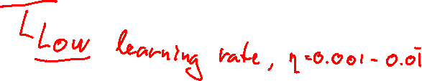
Vanishing gradients
Gradients get smaller by layer
(but sometimes larger - exploding gradients)
Low gradient, low adjustment => network cannot converge
Solutions:
Other activation functions: tanh, ReLU, Swish
Normalize before each layer: Batch normalization
Other optimization algorithms: Adam, AdamW, Nestorov

Slide 21
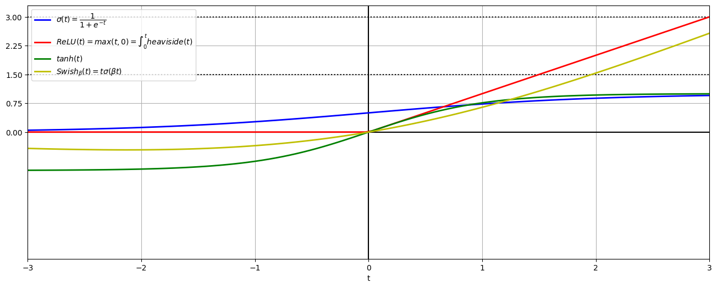
Activation functions

Slide 22
Regularization
Lasso (L1) and Ridge(L2) still work.
Dropout:
During a training step a percent (hyperparameter: rate) of neurons become inactive (output 0)
The rest of the neurons get an equivalent boost to their output: 1/(1-rate)
The idea is that to pick up the slack, the neurons will have to be less specialized
It works surprisingly well

Slide 23
Hyperparameters
One of the good things about neural networks is how flexible they are
One of the bad things about neural networks is how flexible they are
Too many hyperparameters!
Always use train-validation-test.

Slide 24
Code examples
feed-forward.ipynb
digits.ipynb

Slide 25
Look-ahead: Image processing
Pretending images have no shape becomes untenable
So, we'll have to make networks accept 28x28 pixels
Problem:
If 70,000 784-dimensional vectors of pixels is a 70,000x784 matrix,
what is 70,000 28x28 matrices of pixels?

Slide 26
Answer: Tensors
Wolfram MathWorld:
"An nth-rank tensor in m-dimensional space is a mathematical object that has n indices and m^{n} components and obeys certain transformation rules."
In TensorFlow, an n-rank tensor is represented by an n-dimensional array
The requirement that all ranks have same dimension (m) has gone out the window
So has the part about transformation rules
70,000 28x28 images comprise a 3-rank tensor of shape [70000, 28, 28]
Unless they have colors (3 channels) then they are a 4-rank tensor of shape [70000, 28, 28, 3]

Slide 27
Bag of words
Take these texts:
It was the best of times, it was the worst of times
It was the age of wisdom, it was the age of foolishness
it was the epoch of belief, it was the epoch of incredulity
13 different words: 'age', 'belief', 'best', 'epoch', 'foolishness', 'incredulity', 'it', 'of', 'the', 'times', 'was', 'wisdom', 'worst'
Texts as bags of words:
[0, 0, 1, 0, 0, 0, 2, 2, 2, 2, 2, 0, 1]
[2, 0, 0, 0, 1, 0, 2, 2, 2, 0, 2, 1, 0]
[0, 1, 0, 2, 0, 1, 2, 2, 2, 0, 2, 0, 0]

Slide 28
Code example
bag of words.ipynb

